Slide 1
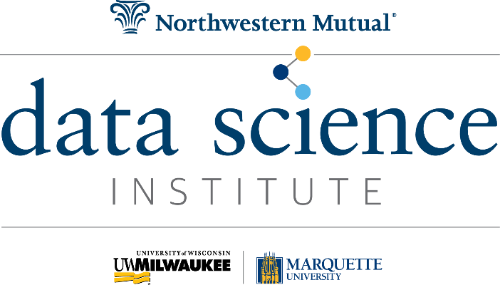
Our Vision
To be a world-class institute that transforms our world through the power of data science.
Our Mission
We inspire and cultivate passion for data science through a unique partnership of academia and industry that galvanizes the brightest minds in the Milwaukee region to solve some of our world’s most pressing problems, fuel wonder and intellectual curiosity, and inspire the next generation of data scientists.
Our Core Values
Intellectual curiosity
Lifelong learning
Creative problem solving
Passion for discovery and exploration
Innovation and creativity
Power of partnership
Entrepreneurship
Highest ethical standards
Commitment to diversity & inclusion
Areas of Focus
Internationally recognized data science research
Education that fuels innovation
Building a strong pipeline of regional talent
Growing startups and inventing
Creating data science thought leadership
Strengthening our communities through data sciences
Build a sustainable and scalable institute

Slide 2
Our Vision
To be a world-class institute that transforms our world through the power of data science.
Our Mission
We inspire and cultivate passion for data science through a unique partnership of academia and industry that galvanizes the brightest minds in the Milwaukee region to solve some of our world’s most pressing problems, fuel wonder and intellectual curiosity, and inspire the next generation of data scientists.
Our Core Values
Intellectual curiosity
Lifelong learning
Creative problem solving
Passion for discovery and exploration
Innovation and creativity
Power of partnership
Entrepreneurship
Highest ethical standards
Commitment to diversity & inclusion
Areas of Focus
Internationally recognized data science research
Education that fuels innovation
Building a strong pipeline of regional talent
Growing startups and inventing
Creating data science thought leadership
Strengthening our communities through data science
Build a sustainable and scalable institute

